Slide 1

Report
Name – Swas Airee

Slide 2
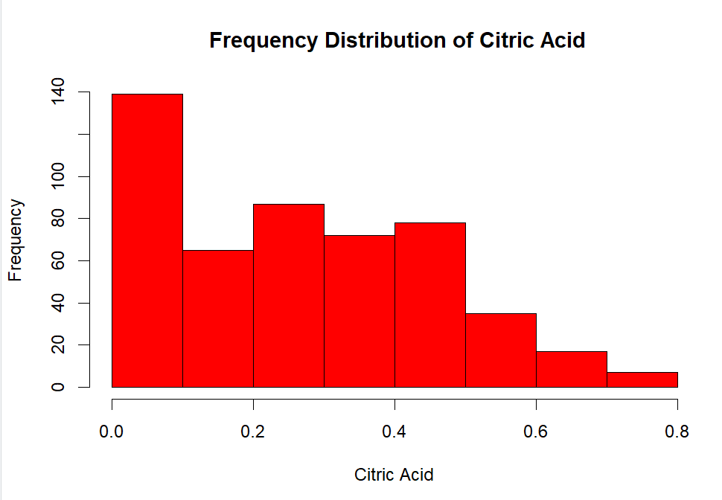
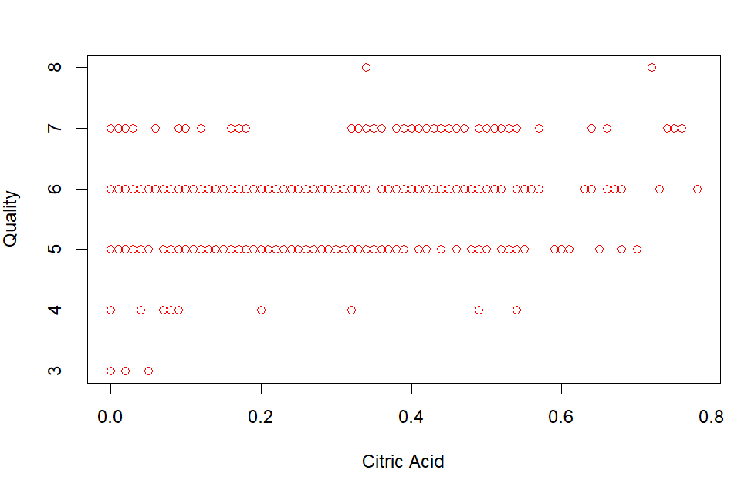
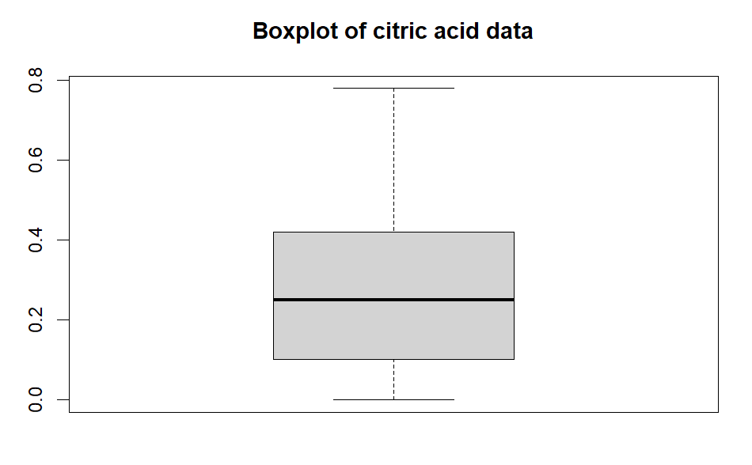
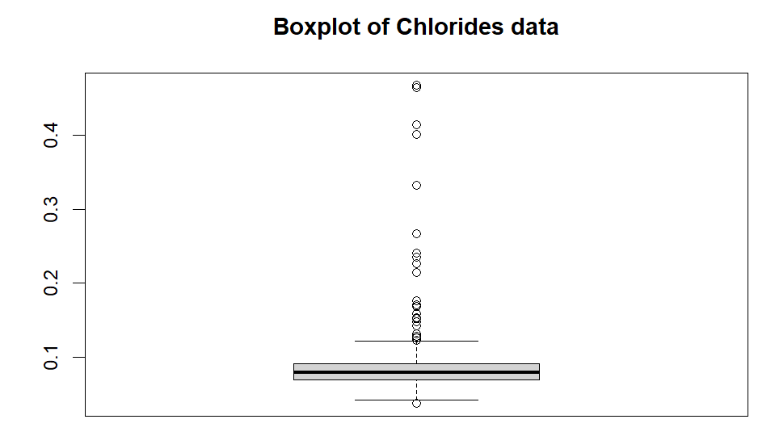
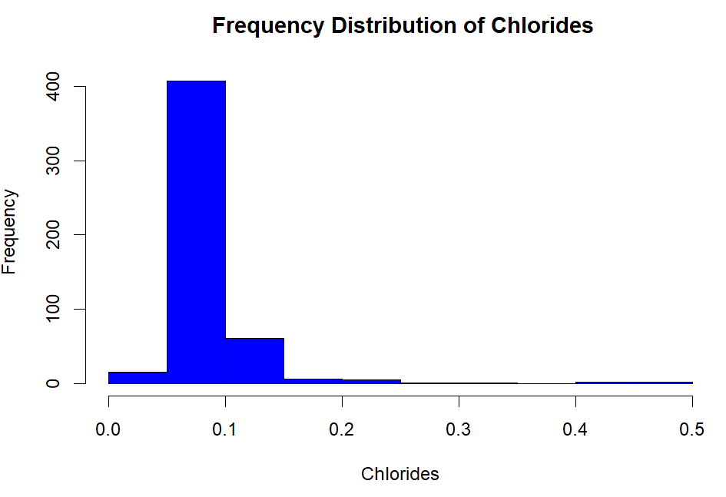
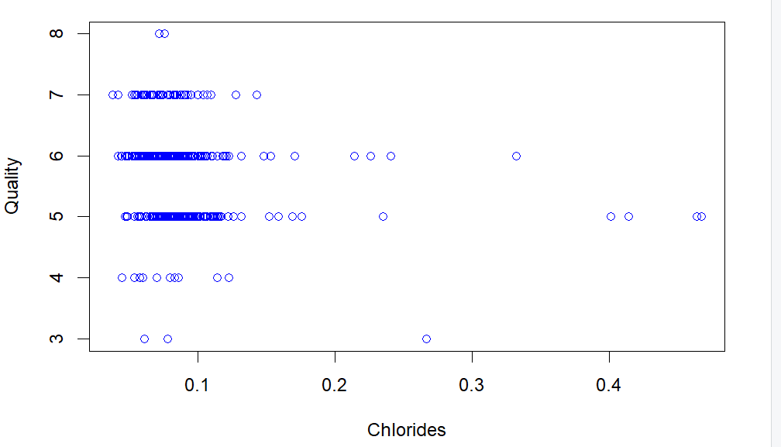
Data Distributions of raw data
Examined through Histogram, scatter plots and Box Plots
Variable 1 (Citric Acid)
Skewness - 0.3477552
Correlation - 0.2180888 (Slight Positive correlation)
Histogram – Shows slight right skewness but looking at the skewness of 0.34 and the boxplot line being relatively in the middle it can be concluded that the distribution is close to normal.
Scatter plot- Most of the data points affect the quality within the range of 5-7
Box plot – shows no outliers and no significant skewness.
Variable 2 (Chlorides)
Skewness - 5.70264
Correlation – -0.1548121 (Slight Negatively correlated)
Histogram – Shows significant positive right side skewness.
Scatter plot- Most of the chloride data points are within 0.0 to 0.2 keeping the quality within the range of 5-7
Box plot – shows significant no. of outliers.

Slide 3
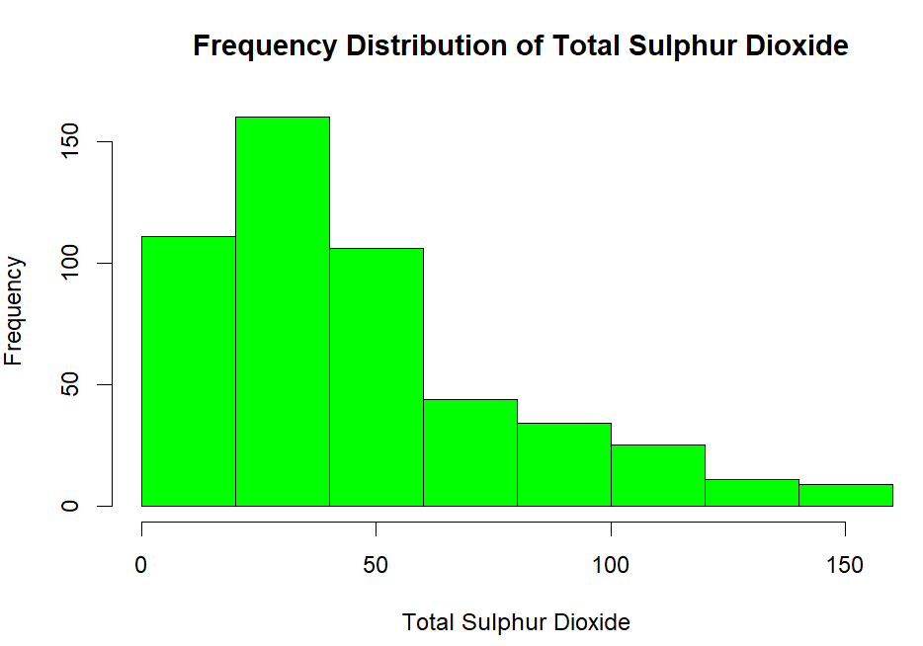
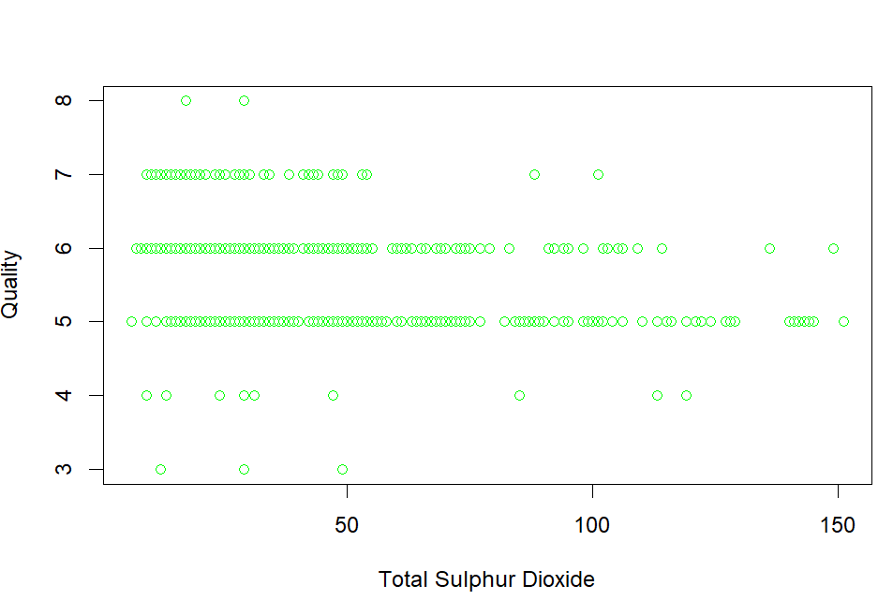
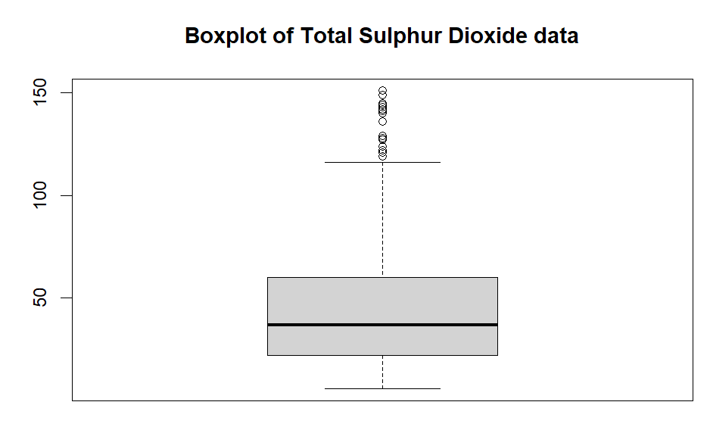
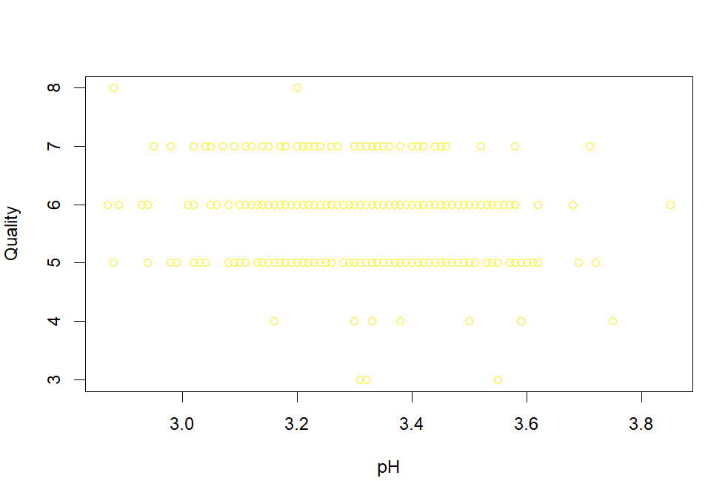
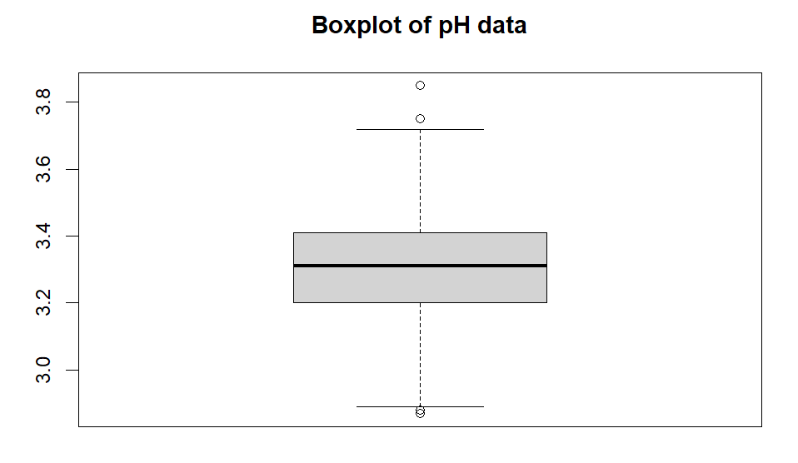
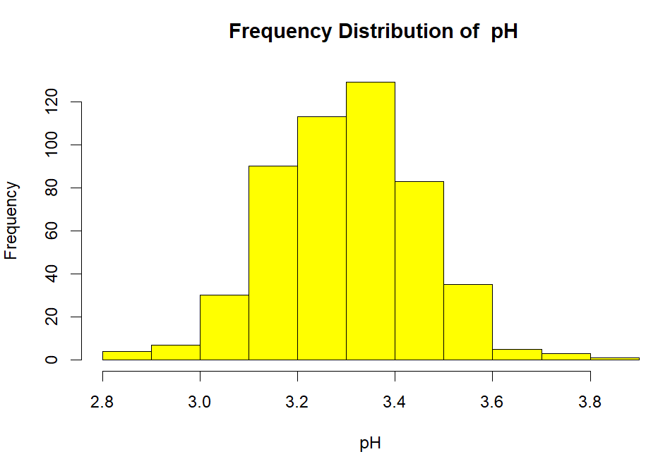
Data Distributions of raw data
Examined through Histogram, scatter plots and Box Plots
Variable 3 (Sulphur Dioxide)
Skewness -1.208125 Positive Right Skewness
Correlation - -0.303163 (Slight Negatively correlated)
Histogram – The data shape appears to be positively skewed
Scatter plot- Most of the sulphur dioxide data points are within 0 to 60 keeping the quality within the range of 5-7
Box plot – shows significant no. of outliers above 120
Variable 4 (pH)
Skewness -0.02114609 (statistically insignificant skewness)
Correlation – -0.05732874 (low negative correlation)
Histogram – The distribution appears to have the shape of a normal distribution.
Scatter plot- Most of the chloride data points are within 3.0 to 3.6 keeping the quality within the range of 5-7
Box plot – very few outliers

Slide 4
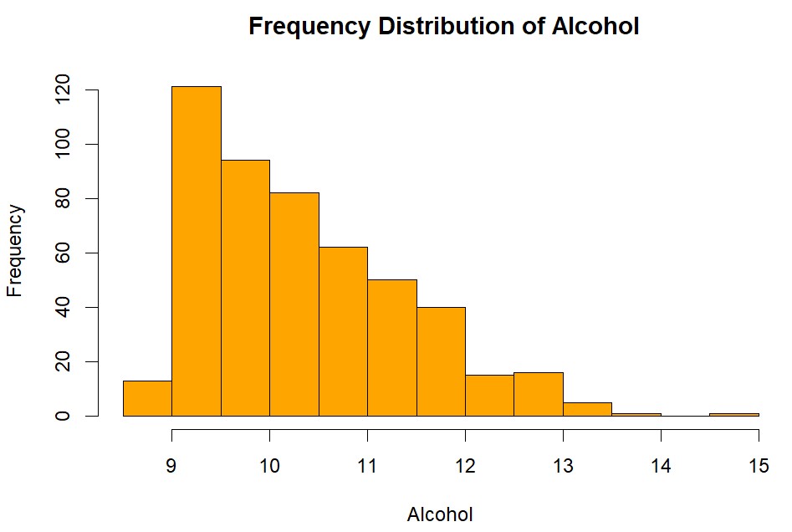
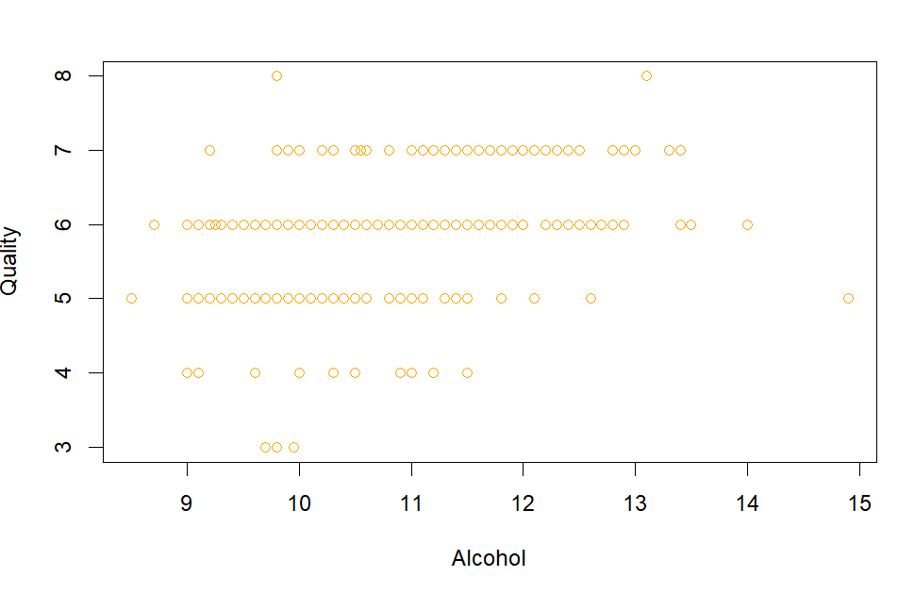
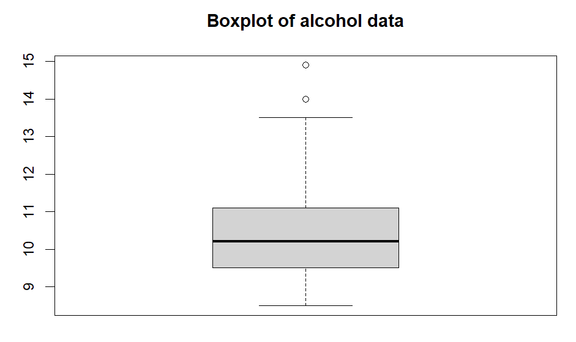
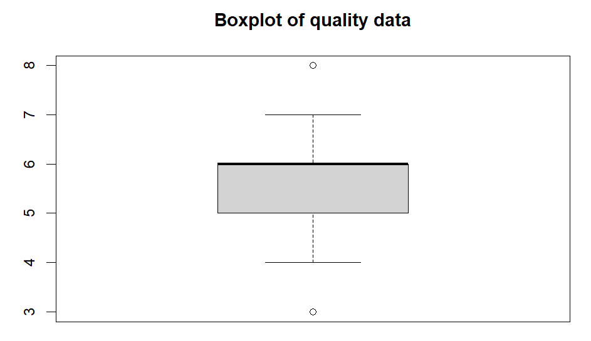
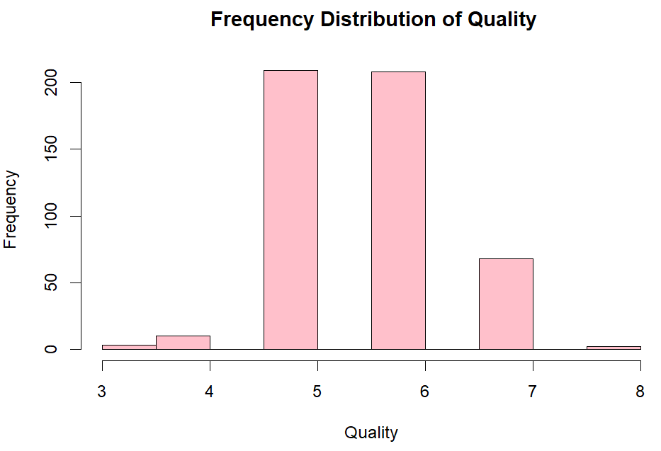
Data Distributions of raw data
Examined through Histogram, scatter plots and Box Plots
Variable 5 (Alcohol)
Skewness - 0.8645457 Positive Right Skewness
Correlation - 0.4901674 (Positive correlation)
Histogram – The data shape appears to be positively skewed
Scatter plot- Most of the Alcohol data points are within 9-12 keeping the quality within the range of 5-7
Box plot – shows only 2 outliers
Variable 6 (Quality)
Skewness - 0.122015 (Slight Positive Right Skewness)
Histogram – The data shape of normal distribution.
Box plot – shows only 2 outliers

Slide 5
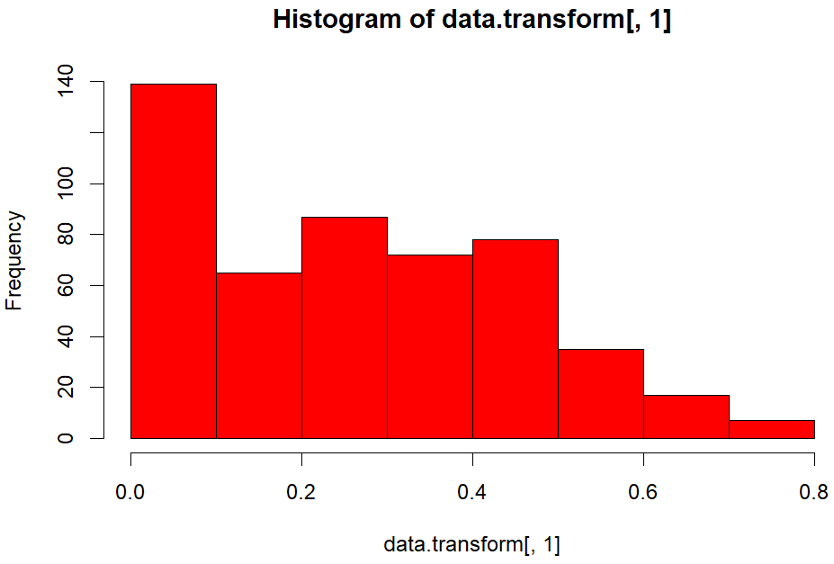
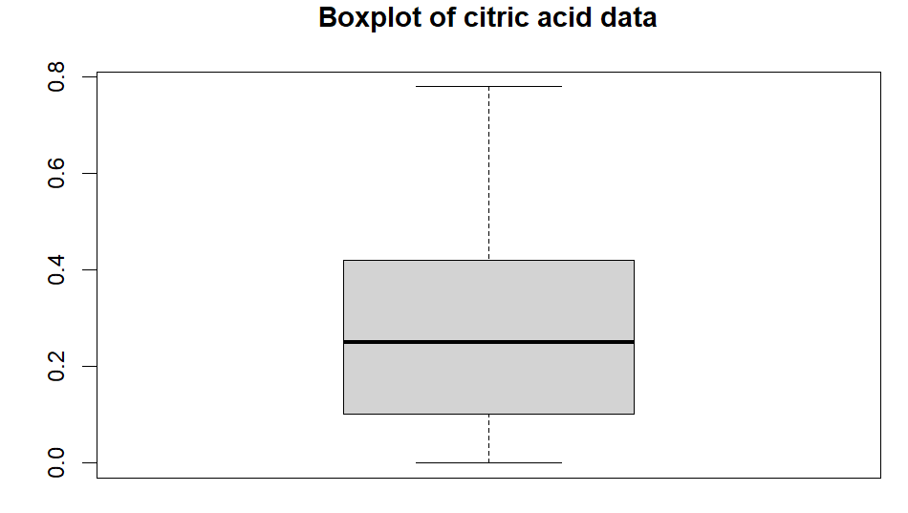
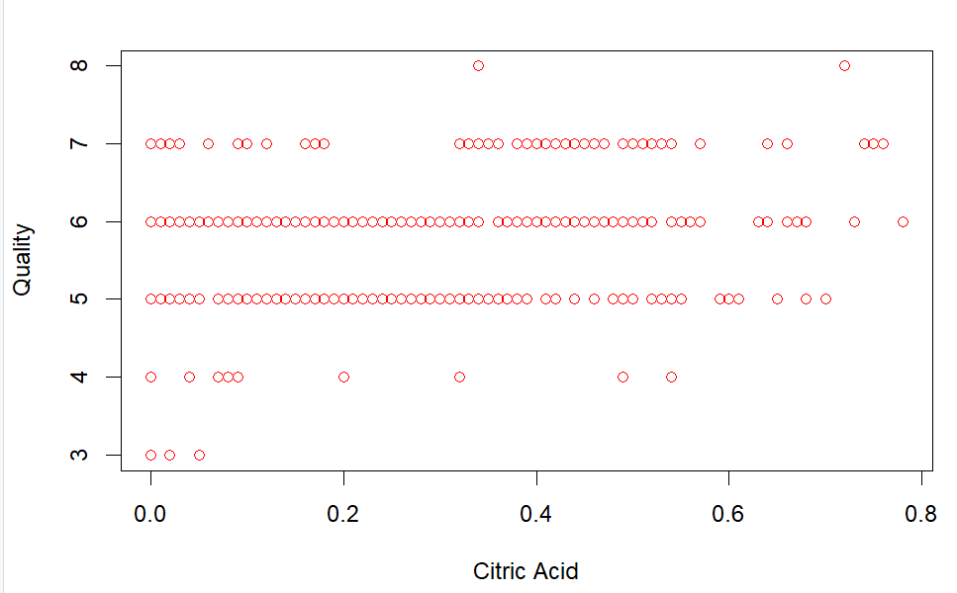
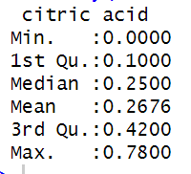
transformations applied for the selected four variables and variable of interest
Variable 1 (Citric Acid)
The variable holds the skewness of 0.3477552 , all the data points are within the range of 0-1 which is in range between -0.5 to 0.5 has no outliers and has positive correlation to Quality. Thus this variable requires no transformation.

Slide 6
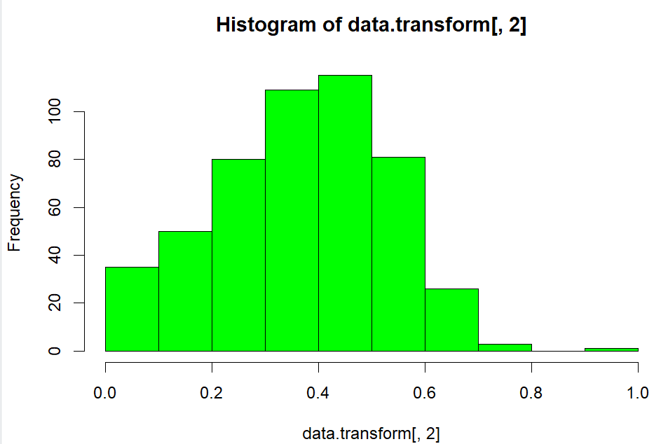
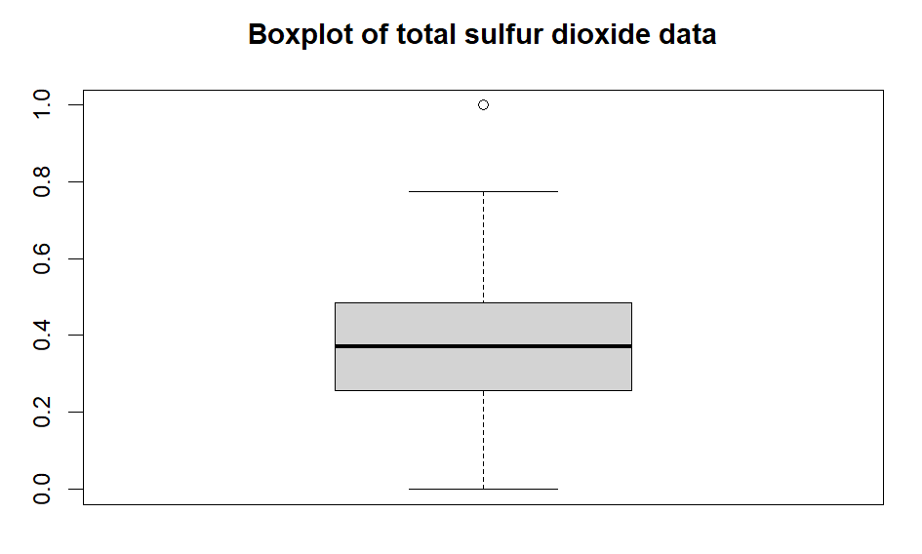
transformations applied for the selected four variables and variable of interest
Variable 2 (Citric Acid)
Pre transformation this data set had skewness of skewness of -1.208125 which is more than the range of 0.5 to -0.5 and negative correlation of - -0.303163 further, the data range is outside of 0-1 required for aggregation
To correct the data range Liner Feature Scaling was used to bring the data set range between 0-1
To correct the extreme right positive skewness Polynomial Transformation using p =0.3 was applied to bring skewness down to -0.05749057
To correct negative correlation of -0.303163 negation transformation was applied to change to direction of the distribution and change correlation to 0.2762519
Post transformation we can observe the distribution is now shaped as bell shaped i.e Normal distribution with data values between 0-1 and the multiple outliers have been reduced to 1.

Slide 7
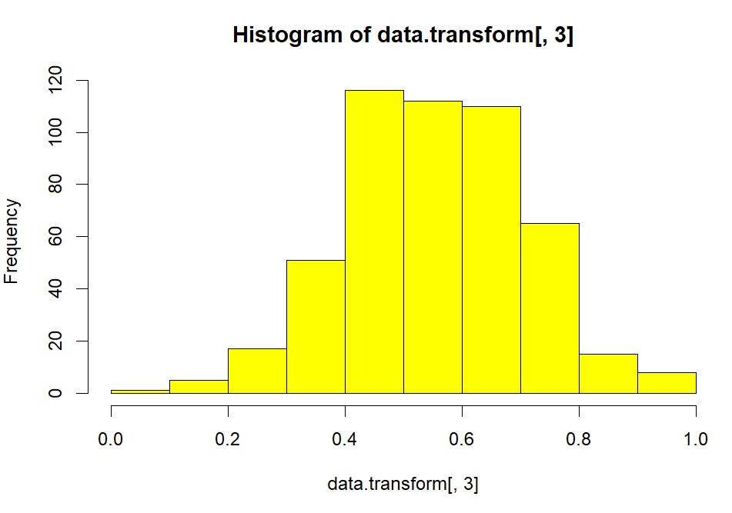
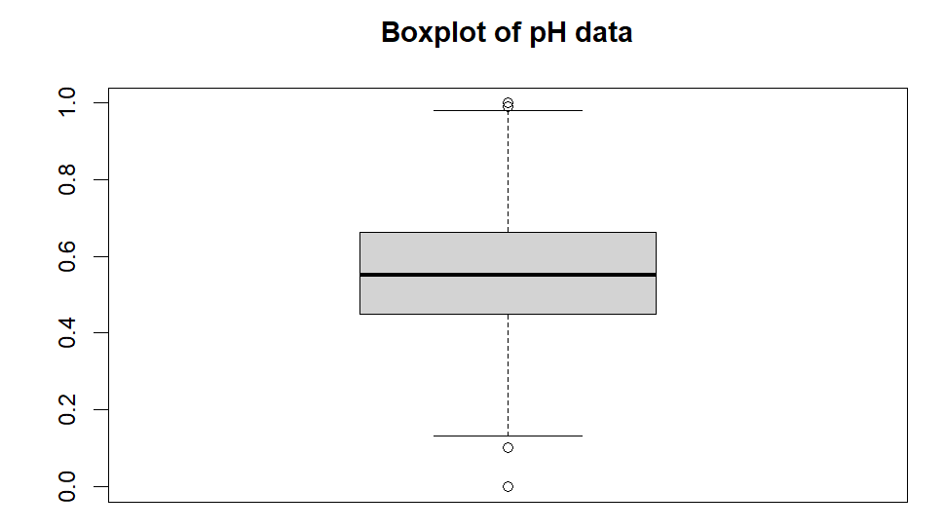
transformations applied for the selected four variables and variable of interest
Variable 3 (pH)
Pre transformation this data set had skewness of skewness of 0.02114609 which is within 0.5 to -0.5 and negative correlation of -0.05732874 further, the data range is outside of 0-1 required for aggregation
To correct the data range Liner Feature Scaling was used to bring the data set range between 0-1
To correct negative correlation of of -0.05732874 negation transformation was applied to change to direction of the distribution and change correlation to 0.05732874
Post transformation we can observe the distribution is still shaped as bell shaped i.e Normal distribution with data values between 0-1.

Slide 8
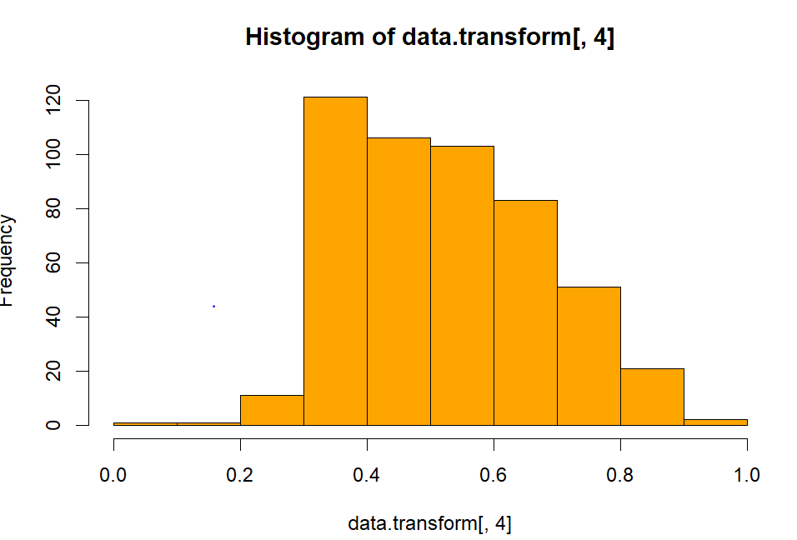
transformations applied for the selected four variables and variable of interest
Variable 4 (Alcohol)
Pre transformation this data set had skewness of skewness of - 0.8645457 which is more than the range of 0.5 to -0.5 and Positive correlation of - 0.4901674 further, the data range is outside of 0-1 required for aggregation
To correct the data range Liner Feature Scaling was used to bring the data set range between 0-1
To correct the extreme right positive skewness Polynomial Transformation using p =0.5 was applied to bring skewness down to 0.2692092
Post transformation we can observe the distribution is now shaped as bell shaped i.e Normal distribution with data values between 0-1.

Slide 9
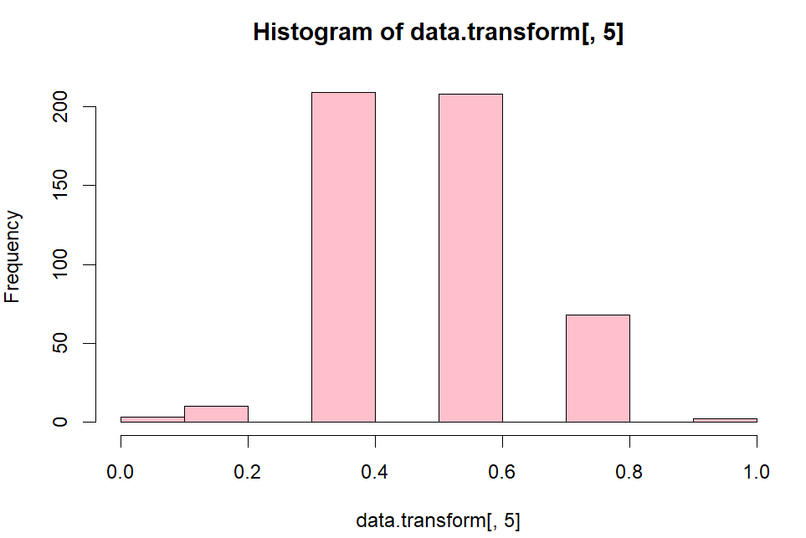
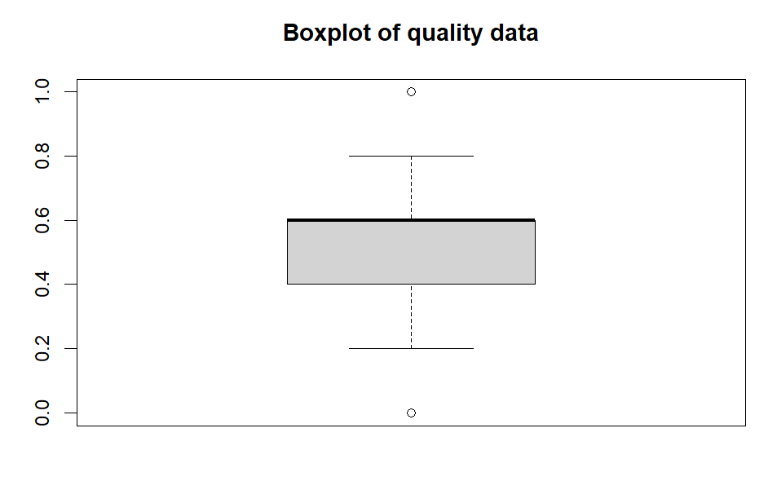
transformations applied for the selected four variables and variable of interest
Variable 5 (Quality)
Pre transformation this data set had skewness of skewness of - 0.122015 which is within the the range of 0.5 and the data range is outside of 0-1 required for aggregation
To correct the data range Liner Feature Scaling was used to bring the data set range between 0-1
Post transformation we can observe the distribution is still shaped as bell shaped i.e Normal distribution with data values between 0-1.

Slide 10
error measures and correlation coefficients Table
Model | Average ABS Error | Pearson Correlation | Spearman Correlation | RMSE(Root Mean Square Error)
WAM | 0.101899973272004 | 0.528773260834755 | 0.552476414536778 | 0.134597864021928
WPM (p= 0.5) | 0.102079486139245 | 0.526376348139486 | 0.552160402574025 | 0.134749347871327
WPM (p=2) | 0.102276559398587 | 0.523921056711041 | 0.547314418256799 | 0.135705504968896
OWA | 0.143350698469421 | 0.420998396759117 | 0.416902528946409 | 0.143350698469421
As the ABS Error and RMSE Error are the lowest for WAM and Pearson and Spearmen correlation coefficient are closest to 1 for WAM thus making WAM best fitted model to predict variable Y(Quality)

Slide 11
Weights and parameters summary table
Model | Weight (Variable X1) | Weight (Variable X2) | Weight (Variable X3) | Weight (Variable X4)
WAM | 0.00861502381904488 | 0.106953353466349 | 0.192342947335229 | 0.692088675379377
WPM (p= 0.5) | 0 | 0.0736485950576081 | 0.231211831163144 | 0.695139573779248
WPM (p=2) | 0.0579246773569518 | 0.156190305745181 | 0.130283677600744 | 0.655601339297123
OWA | 0 | 0.276087468096067 | 0.370805006565943 | 0.353107525337989

Slide 12
importance of Selected variables
Citric acid - Contributes acidity, freshness, and citrus-like flavor, at the same time as performing as a preservative to beautify wine high-quality.
Total sulfur dioxide - Acts as an antioxidant and antimicrobial agent, preserving freshness and taste while stopping oxidation and spoilage.
pH - Influences chemical reactions, microbial stability, and sensory belief, critical for retaining stability and quality in wine.
Alcohol - Impacts body, mouthfeel, and taste depth, balancing sweetness and richness to decorate ordinary wine great.

Slide 13
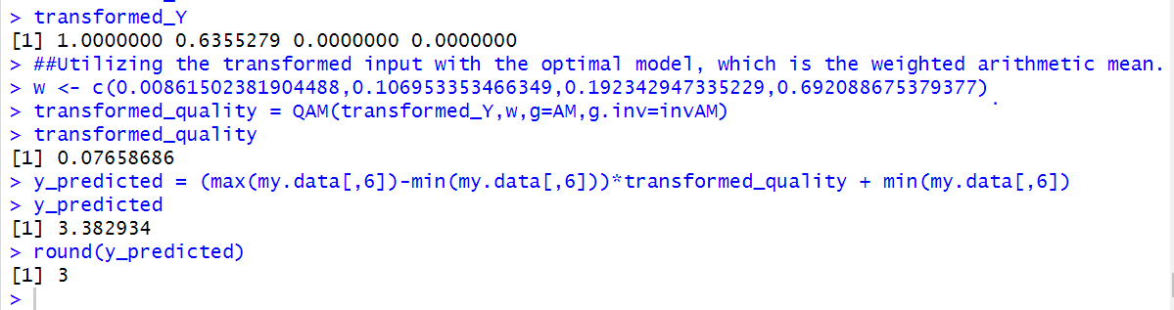
prediction result
X Variable | Original Value | Dataset Range | New Min/Max
X1 | 0.9 | 0.00 - 0.78 | New Max
X3 | 38 | 6 - 151 | -
X4 | 2.53 | 2.87 - 3.85 | New Min
X5 | 7.1 | 8.50 - 14.90 | New Min
Using the provided x variable inputs, the predicted wine quality is 0.9, 0.65, 38, 2.53, and 7.1.

Slide 14
best conditions to predict high quality wine
Based on the analysis findings, optimal conditions for producing higher quality wine include:
Citric Acid - 0.34 - 0.72
Sulfer dioxide – 17 – 29
pH – 2.88 – 3.2
Alcohol – 9.8 – 13.1

Slide 15
limitations of the fitting model
The pleasant of red wine is stimulated via greater than simply its chemical composition and elements, consisting of processing strategies and environmental factors.
Wine first-class is inherently subjective, posing a assignment to accurate prediction models.
The becoming features used inside the model might also lack sophistication compared to opportunity methods, doubtlessly decreasing accuracy.
Limited variable selection increases the threat of overfitting or underfitting in the model.
The geographical restrict of wine samples to a selected location of Portugal's north limits the version's ability to generalize high-quality conclusions.

Slide 16
References
GeeksforGeeks. (2020). Data Transformation in Data Mining. [online] Available at: https://www.geeksforgeeks.org/data-transformation-in-data-mining/.
Rcompanion.org. (2016). R Handbook: Transforming Data. [online] Available at: https://rcompanion.org/handbook/I_12.html.
Statistics Globe. (n.d.). Weighted Mean in R (5 Examples) | weighted.mean, weightedMean, wt.mean. [online] Available at: https://statisticsglobe.com/weighted-mean-in-r-example.

Slide 17
Thank You

